Slide 1
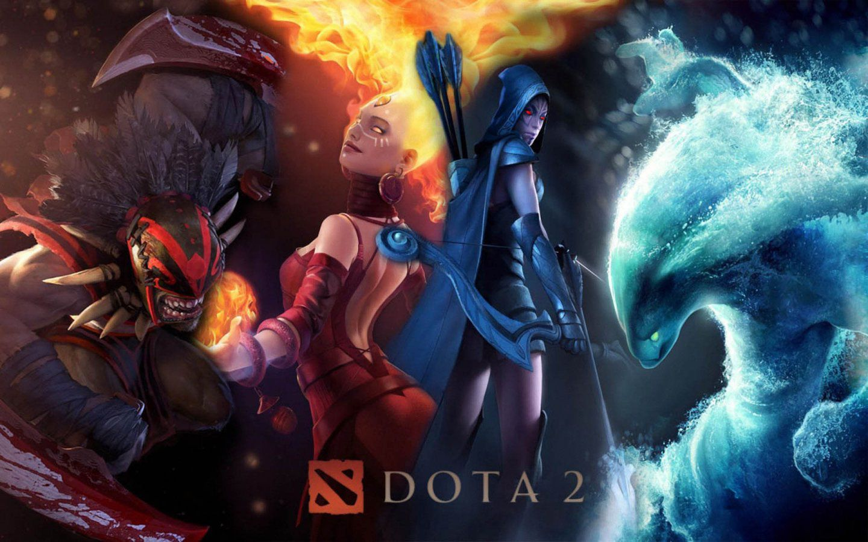

Slide 2

Game
Father of a Genre: Multiplayer Online Battle Arena (MOBA)
Competitive Action RTS
Developed by Valve

Slide 3
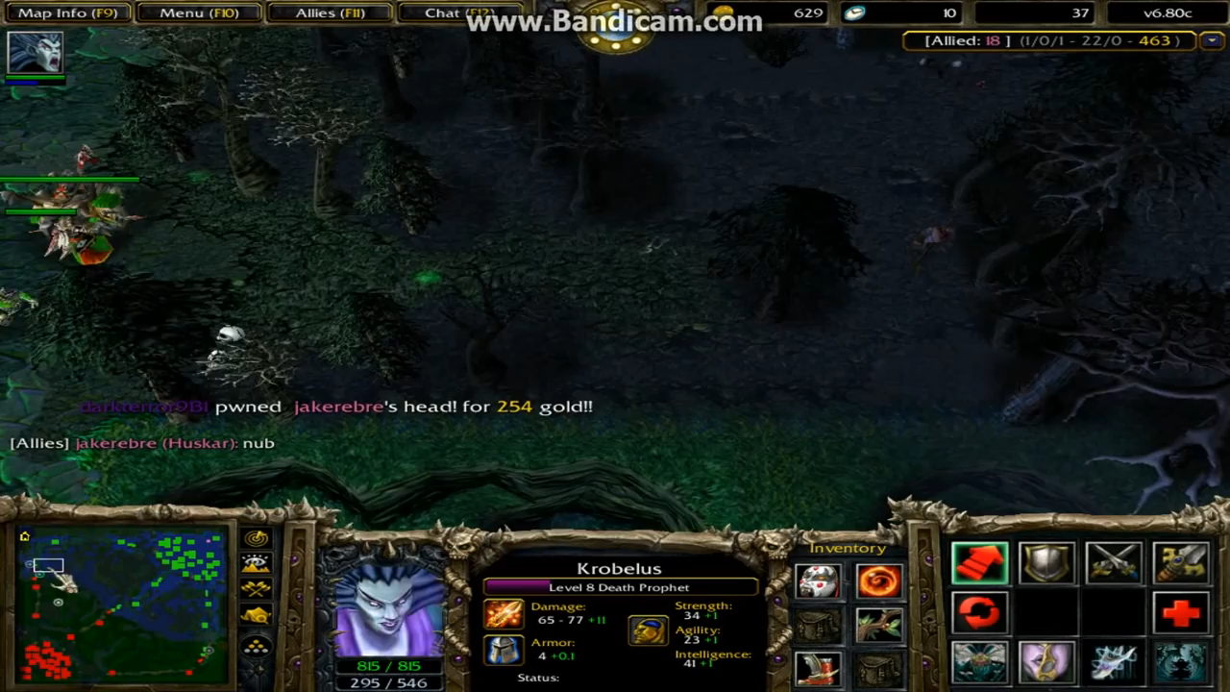
History
Earliest ancestor, mod for Starcraft - Aeon of Strife
Idea moved to Warcraft 3 – Mod was rebuilt as Defense of the Ancients
Popularity exploded
Frozen Throne and mod builder expansion for WC3
Lots of spinoffs
Couple of dudes took the most popular spinoff content and compiled it into DotA Allstars – “The DotA”
Main developer, Steve “Guinsoo” Feak, and forum owner, Steve “Pendragon” Mescon leave. Goes to work at Riot as developers for LoL. Mescon still operates dota-allstars.com
Last developer, IceFrog (no identity), leaves the project to work on Heroes of Newearth, but soon after moves to Valve.
Dota 2 launches in July 2013.
Some dude on YouTube playing DotA All-Stars

Slide 4
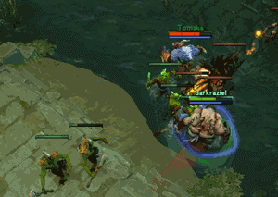

Gameplay
Two teams, The Radiant and The Dire
Each team has five players, each player controls one hero
Players spawn in their team’s fountain upon game start
Opposing players confront each other on a symmetrical-ish map, split by a river
Primary points of contact are the three lanes, which run through the outskirts and directly through the middle of the map
Waves of uncontrollable creeps, one wave in each lane every 30 seconds, spawns for both teams and charges mindlessly through the lane
Players kill creeps and other players to gain experience and gold advantages over the other team
Each lane has four towers (turrets) and a pair of barracks (one for melee creeps and one for ranged creeps)
The players must destroy the towers and the barracks in the lanes to procure an offensive advantage
Primary objective is to destroy the other team’s Ancient

Slide 5
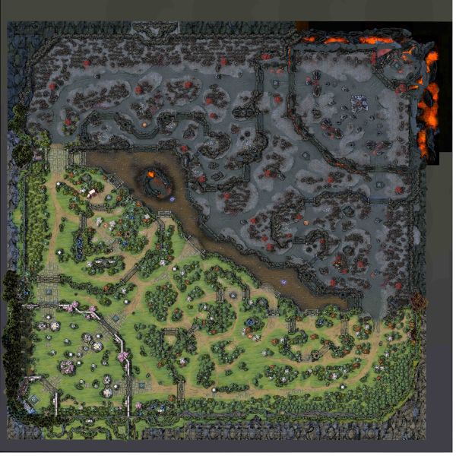

Map
Two sides: Radiant and dire
Split by the river
Each side of the map has:
Hard lane – Shorter lane; farming is less safe
Safe Lane – Longer lane; farming is more safe due to more vision
Mid Lane – The guy who wants the fastest power spike goes here
Jungle – Filled with neutral creeps, alternative gold/exp source
Base – Heroes and creeps spawn and heal here, location of the barracks and Ancient, as well as the primary shop for buying/building items
Secret shop – Certain items can only be bought here, most items require one item from here as an ingredient
Side shop – Sells basic items for convenience, not used much after laning phase
One Neutral feature: Roshan pit
The DOTA map, as of patch 7.06

Slide 6
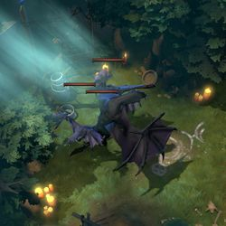
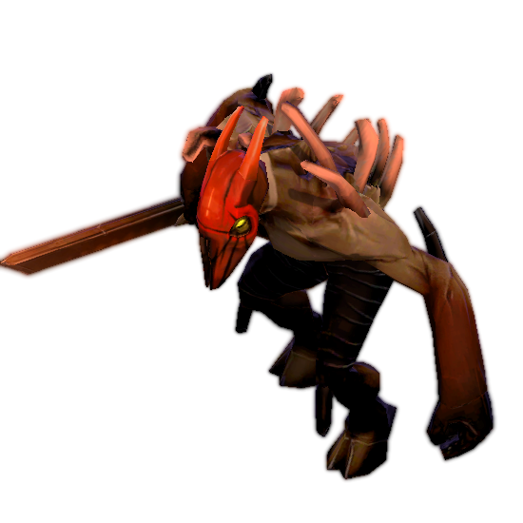
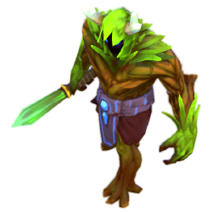
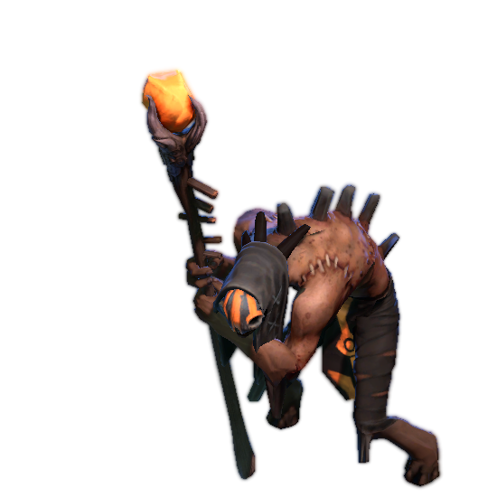
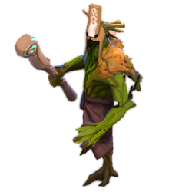
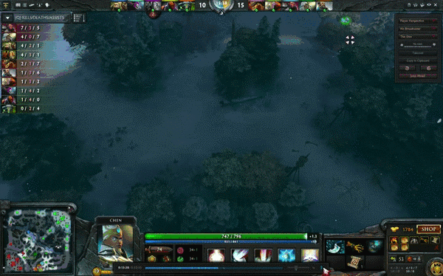
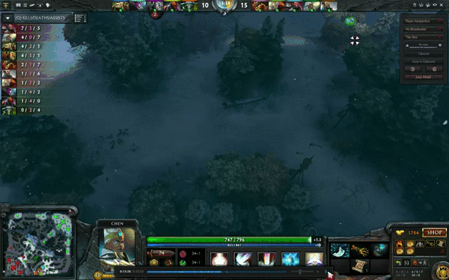
Creeps
Three classes of creep:
Lane Creep
Melee creep
Ranged creep
Siege creep
Neutral (Jungle) Creep
Spawn in camps in both jungles at the top of every minute
Controlled Creep
Creeps controlled by player – spawned by items or hero abilities

Slide 7
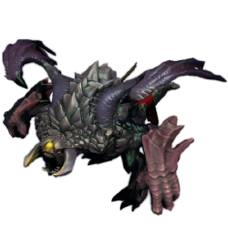
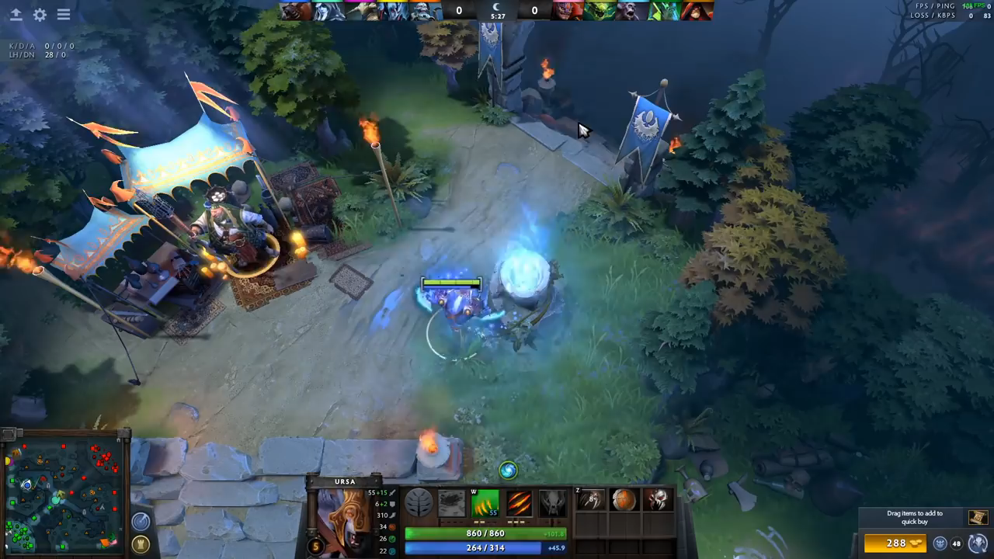
Special type of neutral creep
Found in Roshan’s pit
Gets increased HP, damage, and armor every minute
Benefits of killing Roshan:
200 gold to every player on the team that lands the last hit
Always drops the Aegis of the Immortal
Drops cheese from second death forward
Drops Refresher shard from third death forward
Respawns 8 to 11 minutes after death
Roshan

Slide 8
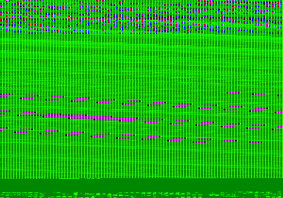
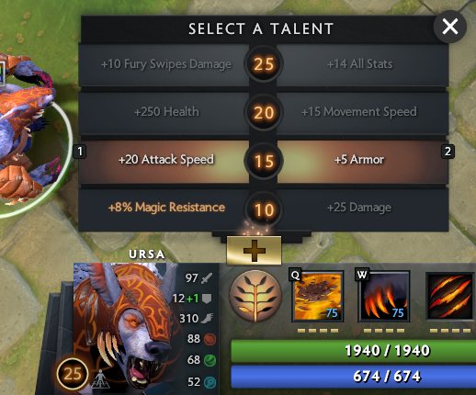
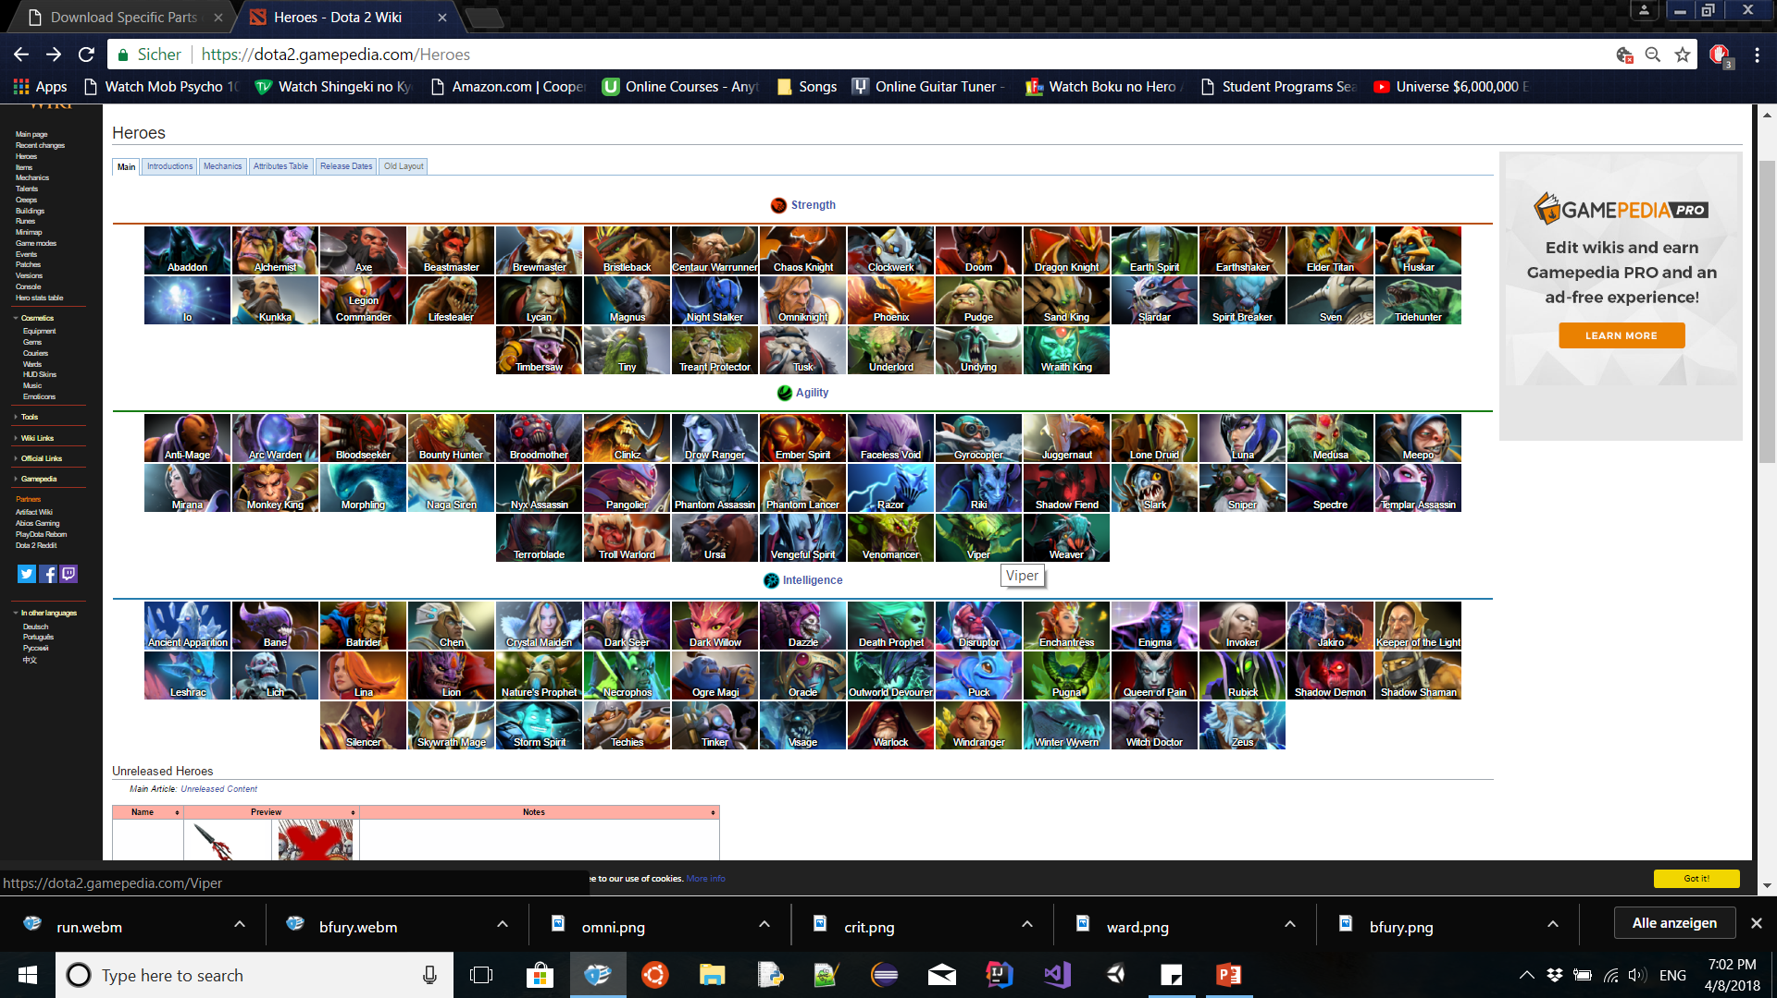
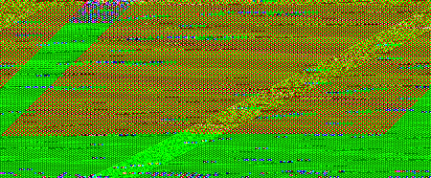
Hero
The character through which the player participates in the game
Each hero (generally) has three standard abilities and one Ultimate ability
Each hero also has a unique talent tree that can be skilled every 5 levels after level 10
Maximum level is 25
Ursa’s talent tree
All Heroes currently available in the game

Slide 9
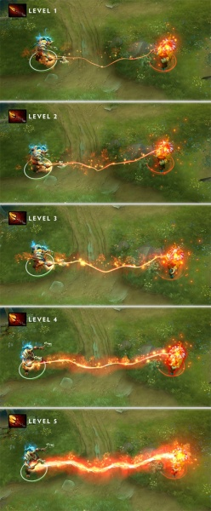
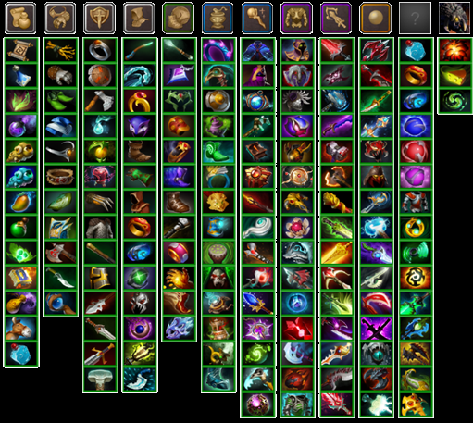
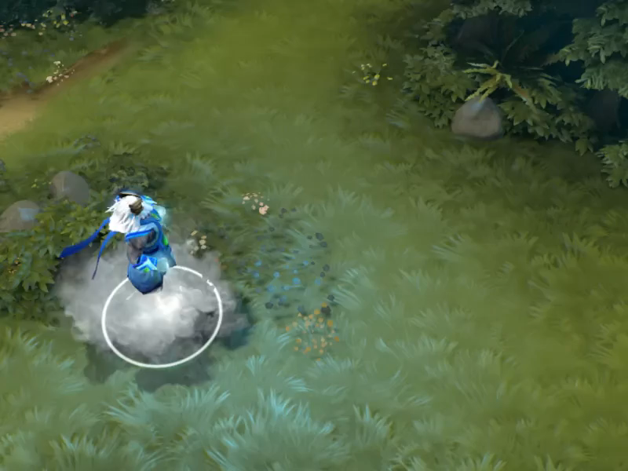

Items
The player uses gold from killing creeps and heroes to purchase items for their hero
Items provide some kind of benefit to the carrying unit, making it more powerful in some way
No item is a must have – You purchase items that work well with your hero and against the other heroes

Slide 10

Music
Default
Dire Shred
International 2016
Abstraction

Slide 11
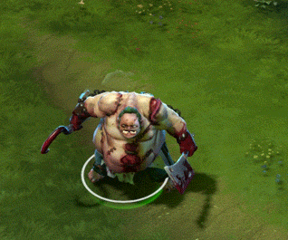

Why this game sucks
Most toxic community of any game ever
Language barrier
Steep learning curve
The only lore is comics
Events kind of suck
Content updates are infrequent
Balance issues

Slide 12
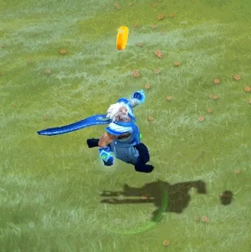


Why this game is great
High customizability
Really hard to get bored
Bug fixes are almost immediate
Lots of character interactions
Economy?
F2P
All heroes are available FROM THE START FOR FREE
You’ll learn a language

Slide 13
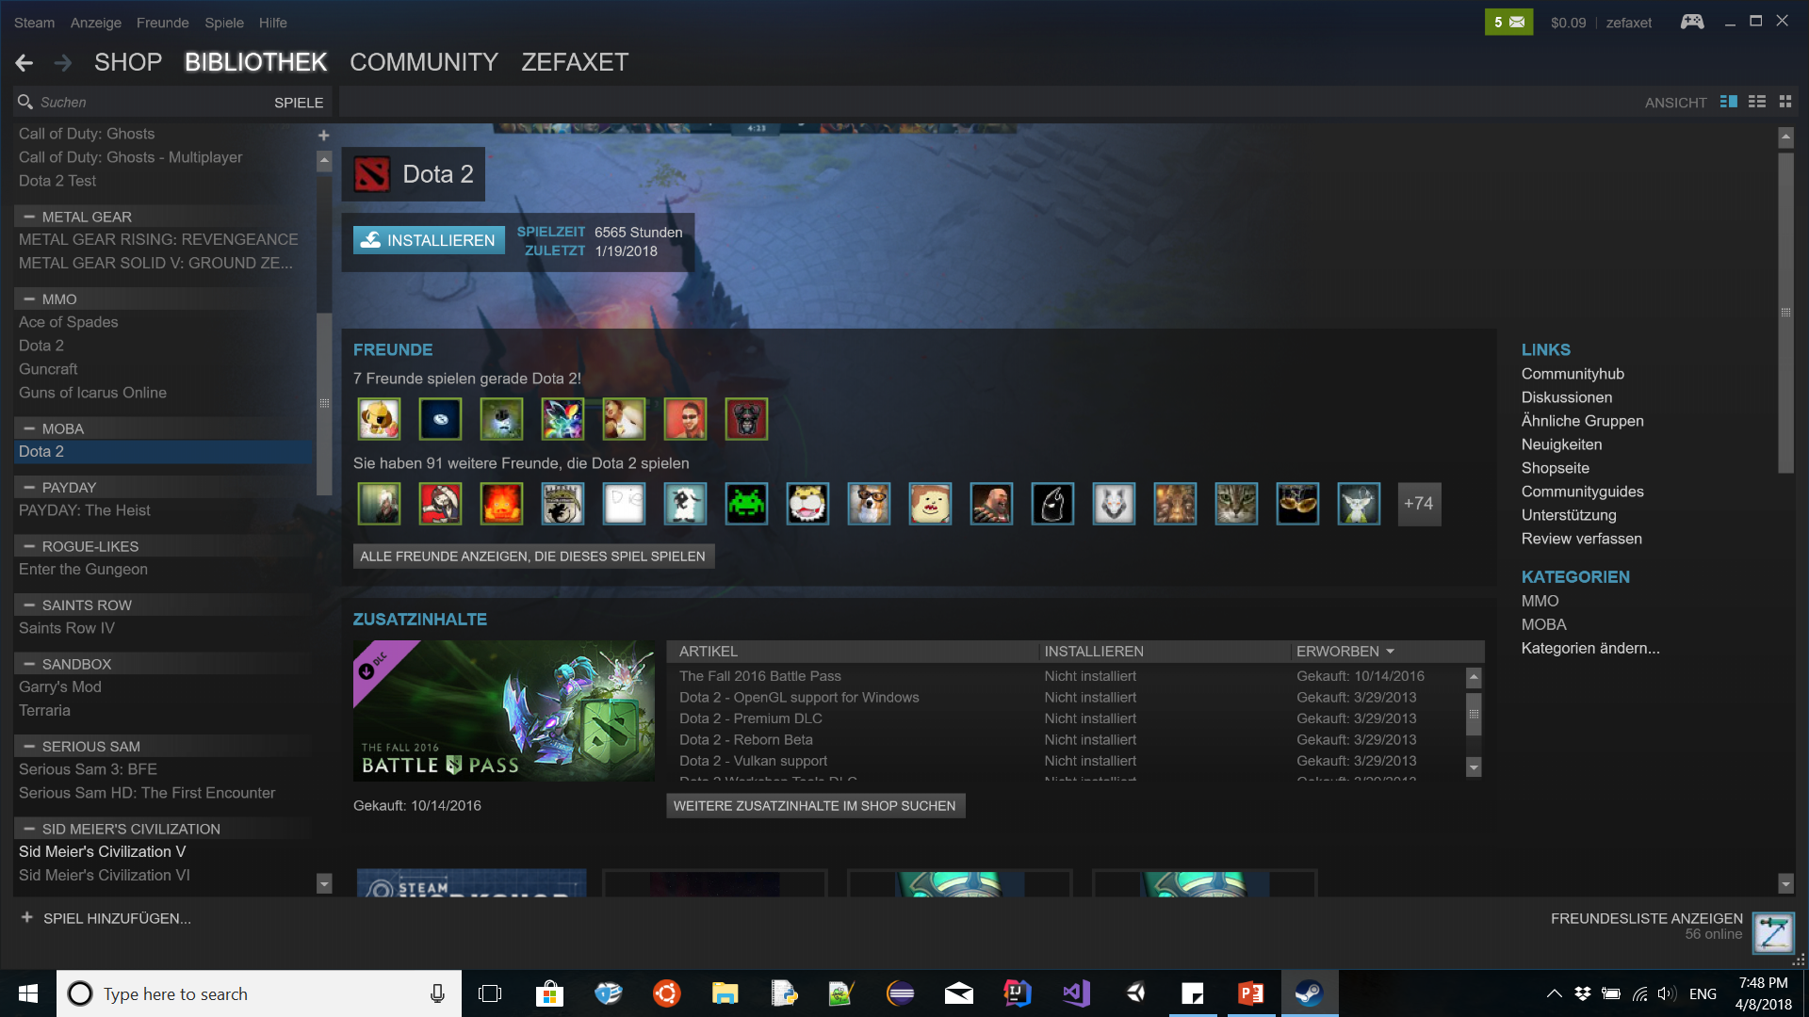

Slide 14
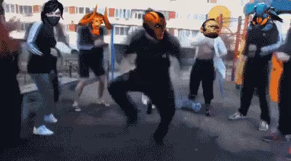
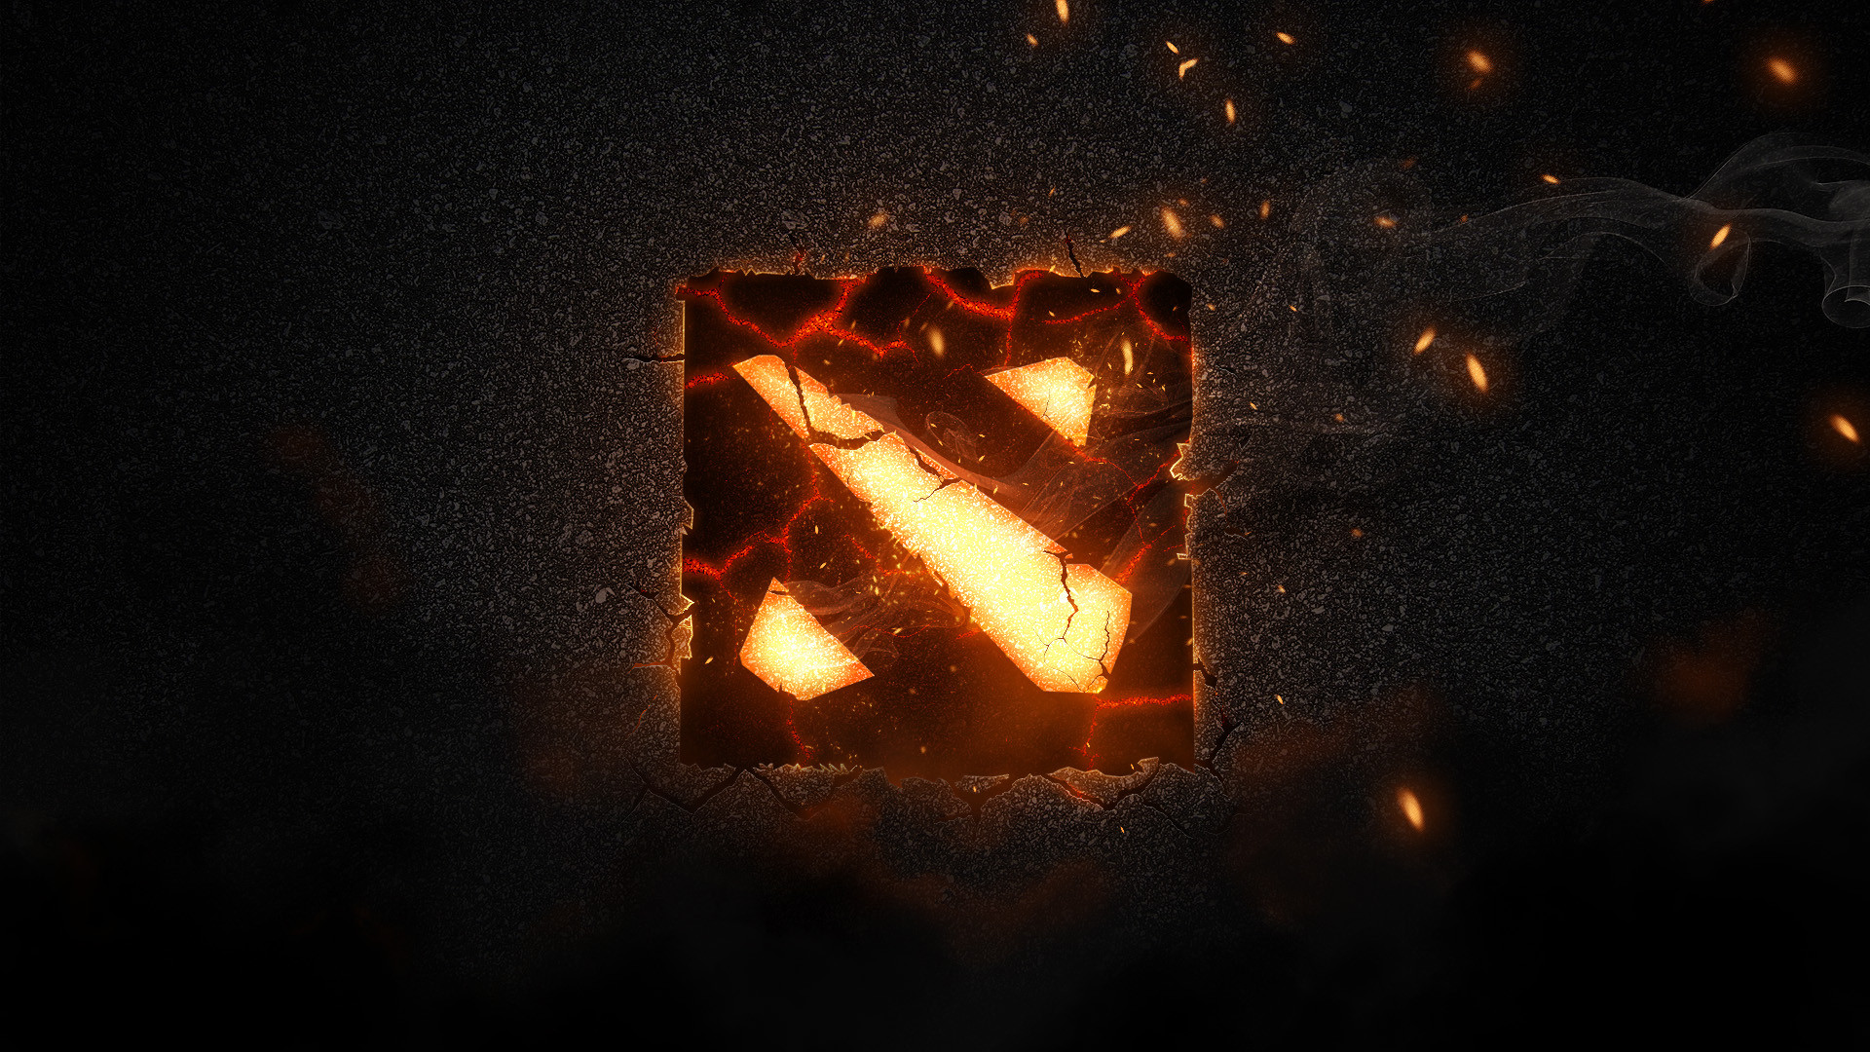
U wan pray game?

